Slide 1
UNIT 3-BOLTZMANN MACHINE
TE AIDS
PROF.SHILPA GAIKWAD

Slide 2
Introduction
Boltzmann Machines are stochastic learning processes having recurrent structure and are the basis of the early optimization techniques used in ANN.
Boltzmann Machine was invented by Geoffrey Hinton and Terry Sejnowski in 1985.
"A Boltzmann Machine is a network of symmetrically connected neurons like units that make stochastic decisions about whether to be on or off."

Slide 3
Boltzmann Machines
This definition means that the Boltzmann Machine works on symmetric networks and decides whether the network will be on or off position by the random probability distribution.
It belongs to the family of unsupervised learning; therefore, the model is solely responsible for decision-making when some input features are provided.
In Boltzmann Machine, the model does not give any output.
In contrast, it is responsible for finding the relationship between the input features.
Boltzmann Machines have an undirected model connection, i.e., they have connected both ways.
For example, if two neurons, A and B, are united both ways.

Slide 4
Boltzmann Machines
Some important points about Boltzmann Machine −
They use recurrent structure.
They consist of stochastic neurons, which have one of the two possible states, either 1 or 0.
Some of the neurons in this are adaptive free state and some are clamped frozen state
If we apply simulated annealing on discrete Hopfield network, then it would become Boltzmann Machine.

Slide 5
Boltzmann Machines
There are two types of nodes in the Boltzmann Machine — Visible nodes — those nodes which we can and do measure, and the Hidden nodes – those nodes which we cannot or do not measure(Fig.1-Boltzman Machine).
Although the node types are different, the Boltzmann machine considers them as the same and everything works as one single system.
The training data is fed into the Boltzmann Machine and the weights of the system are adjusted accordingly.
Boltzmann machines help us understand abnormalities by learning about the working of the system in normal conditions.

Slide 6
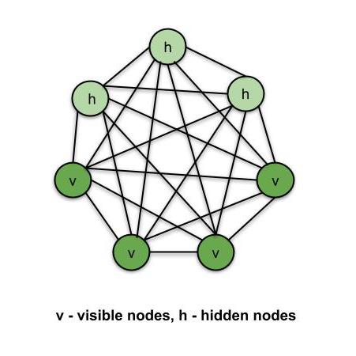
Boltzmann Machines
Fig.1-Boltzmann Machine

Slide 7
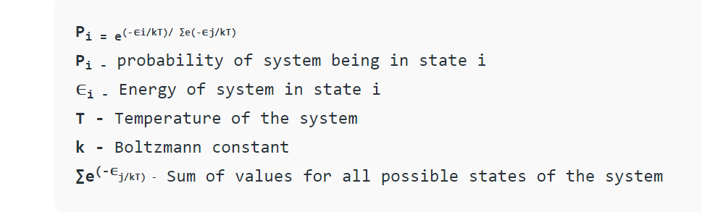
Energy-Based Models
Boltzmann Distribution is used in the sampling distribution of the Boltzmann Machine. The Boltzmann distribution is governed by the equation –

Slide 8
Energy-Based Models
Boltzmann Distribution describes different states of the system and thus Boltzmann machines create different states of the machine using this distribution.
From the above equation, as the energy of system increases, the probability for the system to be in state ‘i’ decreases. Thus, the system is the most stable in its lowest energy state (a gas is most stable when it spreads).
Here, in Boltzmann machines, the energy of the system is defined in terms of the weights of synapses.
Once the system is trained and the weights are set, the system always tries to find the lowest energy state for itself by adjusting the weights.

Slide 9
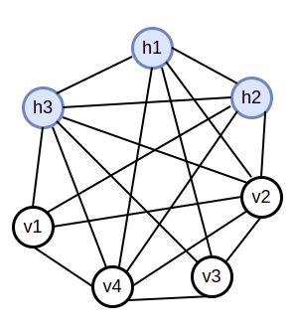
Architecture of Boltzmann Machine
In Boltzmann Machine, we have two layers: the hidden layer and the visible layer.

Slide 10
Architecture of Boltzmann Machine
In this network, the blue neurons (h1, h2, h3) are the hidden layer, and the white neurons (v1, v2, v3, v4) are visible.
Visible neurons are nothing but the input layer.
Each neuron is connected to every neuron, and even the input neurons are connected.
The weights of neurons are used to represent the cost function of neurons.
For example, the weight between v1 and v4, namely W1,4 will define the cost function of V1 and V4 neurons.
Remember, Boltzmann Machine is only accountable for finding the relation between the input layers using the features, not the output.

Slide 11
Training Algorithm
Because Boltzmann machines have fixed weights, there will be no training algorithm because the weights in the network do not need to be updated.
However, before we can test the network, we must first set the weights and determine the consensus function CF.

Slide 12
Training Algorithm
The Boltzmann machine features bidirectional connections on its units Ui and Uj
We're thinking about the fixed weight, wij.
wij ≠ 0 if Ui and Uj are connected.
There is also symmetry in weighted interconnectivity, i.e., wij = wji
There is also wii which is self-connection between units.
For any unit Ui, its state ui would be either 1 or 0.

Slide 13

Training Algorithm
The primary goal of the Boltzmann Machine is to maximize the Consensus Function CF, which can be calculated using the following relation.

Slide 14

Training Algorithm
When the status changes from 1 to 0 or 0 to 1, the change in consensus can be described by the following relation:

Slide 15

Training Algorithm
Here, ui represents the current state of Ui
The following relationship describes the variance in coefficient
(1 – 2ui).

Slide 16

Training Algorithm
In general, unit Ui does not change its state, but if it does, the information is stored locally in the unit.
The network's consensus would increase as a result of this adjustment.
The following relation expresses the probability of the network accepting a change in the unit's state.
Here, T is the controlling parameter. It will decrease as CF reaches the maximum value.

Slide 17
Testing Algorithm
Step 1 − To begin the training, use the following commands.
Weights expressing the problem's restriction
T is a control parameter.
Step 2 − When the stopping condition is not met, proceed to steps 3-8.
Step 3 − Steps 4–7 must be completed.
Step 4 −Assume that one of the states has changed the weight and randomly pick the integers I and J between 1 and n.
Step 5 −Calculate the difference in consensus as follows:

Slide 18


Step 6 −Determine the likelihood that this network will accept the state change

Slide 19
Step 7 −Accept or reject the following change:
Case I − if R < AF, accept the change.
Case II − if R ≥ AF, reject the change.
R represents a random number between 0 and 1.
Step 8 − Reduce the temperature of the control parameter as follows
T new = ⁡0.95T old
Step 9 − Check for the following possible stopping conditions:
The temperature has reached a predetermined level.
For a set number of iterations, there is no change in state.

Slide 20
Types of Boltzmann machines
There are three types of Boltzmann machines
Restricted Boltzmann machine
A restricted term means we cannot connect the same type of layer.
In other words, the two neurons in the input or hidden layer cannot communicate even though the hidden and visible layers can be linked.
Because there is no output layer in this machine, the question of how we will identify, update the weights, and measure whether our prediction is correct or not arises.
All of the questions have a single answer: Restricted Boltzmann Machine.
Geoffrey Hinton (2007) proposed the RBM algorithm, which learns probability distributions from sample training data inputs.
It has widespread use in supervised and unsupervised machine learning applications such as feature learning, dimensionality reduction, classification, collaborative filtering, and topic modeling

Slide 21
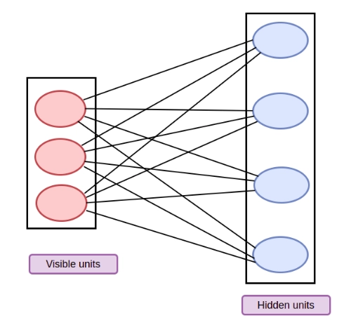
Types of Boltzmann Machines
FIG.2-Restricted Boltzmann machine

Slide 22
Deep Boltzmann machine
As shown in Fig.3, a deep Boltzmann machine is a model with additional hidden layers and directionless connections between the nodes.
DBM learns features from raw data in a hierarchical manner, and the features recovered in one layer are applied as hidden variables as input to the subsequent layer.
To define the training information, weight initialization, and adjustment parameters, the DBM training method must be modified.
According to the DBM, temporal complexity limitations will occur when the parameters are set to ideal.
Montavon et al presented a centering optimization strategy to make the learning process more robust and for midsized DBM to construct a generative, quicker, and discriminative model.

Slide 23
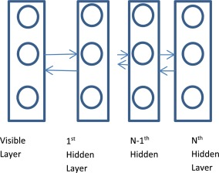
FIG.3-Deep Boltzmann machine

Slide 24
Deep Belief Network
The Deep Belief Network is one of the types of Boltzmann machine. It is a generative model which uses multiple stacks of the deep architecture of the Restricted Boltzmann Machine.
Each restricted Boltzmann machine performs a non-linear transformation on the input neurons and produces the outputs that serve as the input for the consecutive model.
Deep Belief Networks can act supervised or unsupervised as they have a generative model.
Due to it, Deep Belief Networks has a lot of flexibility, and it is easier to expand

Slide 25
Applications of Boltzmann Machine
Boltzmann Machine is used for solving various types of real-world problems:
A search problem
In the Boltzmann machine, the weights of the neuron network are fixed. They are used to represent the cost function of an optimization problem. The Boltzmann machine's stochastic dynamics allow the sample of the binary vectors and represent an excellent solution to the optimization problem.
A learning problem
The Boltzmann machine is given a set of binary vectors for learning problems. It finds the weights of each network so that it can provide a better solution. To solve this problem, the Boltzmann machine takes minute updates to the importance, and each update needs to solve various search problems. The Boltzmann device has the first to solve multiple minor search problems to solve a learning problem.
Handwritten Digit Recognition
Many applications, including data entry, office computerization, check verification, and criminal evidence, use it as a prevalent problem. Additionally, it has drawbacks, including inconsistent writing styles, size and shape inconsistencies, and picture noise that alters the topology of the numerals. For digit recognition in this, a hybrid RBM-CNN algorithm is applied. First, RBM deep learning techniques are used to extract the features. The CNN deep learning system is then fed the retrieved features for categorization. The ability to extract features from input data is a strong suit of RBMs. By introducing hidden units in an unsupervised manner, it is created in a way that it can extract the discriminative characteristics from vast and complex datasets.

